Slide 1



Coffee Sales Prediction
Rachata Kaewviset

Slide 2
Goal
predict quantity of each menu we can sales each day
sunday
monday
tuesday
4 cup
6 cup
3 cup

Slide 3
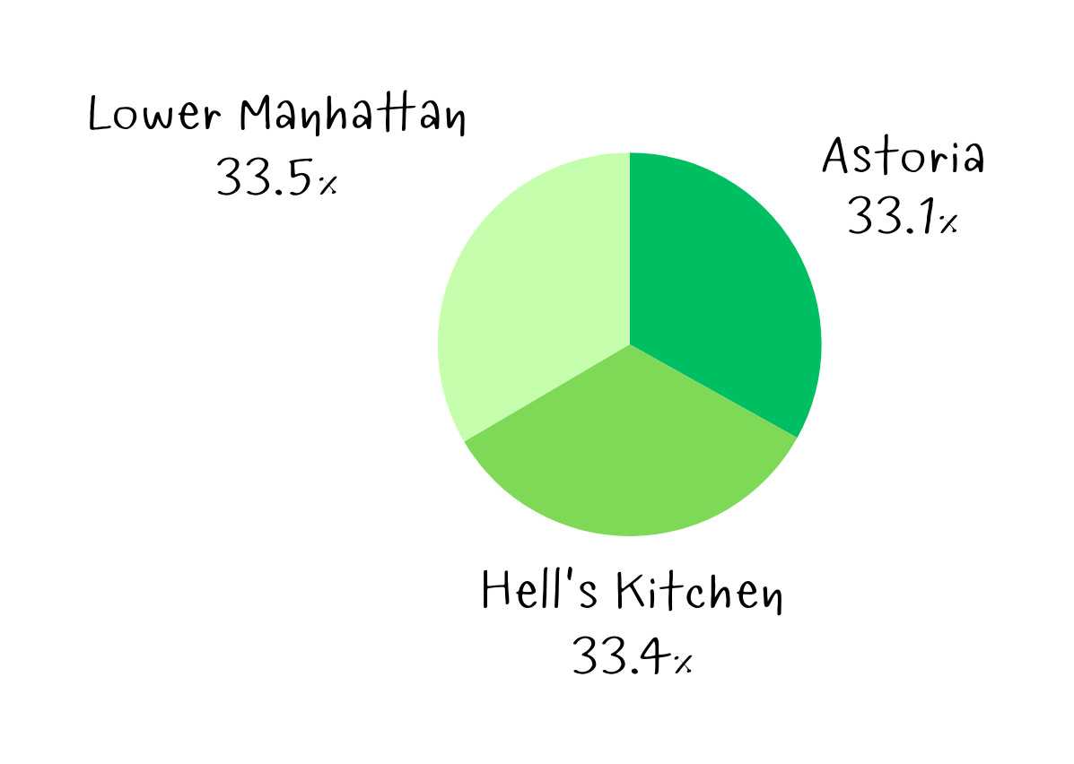
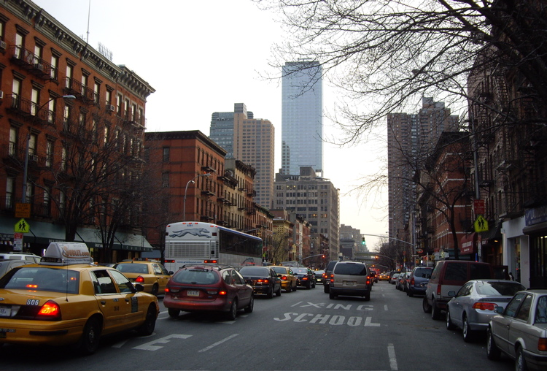

Dataset
150000 transaction from coffee shop from 3 town in usa
≈

Slide 4
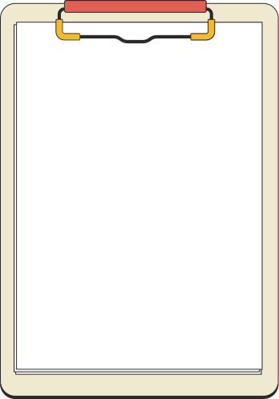
feature selection
feature we have
transaction id
transaction date
transaction time
store id
store location
product id
transaction quantity
unit price
Total Bill
product category
feature we want
unit price
product category
product type
Size
Day Name
transaction quantity (target value)
product type
product detail
Size
Month
Name
Day Name
Hour
Month
Day of Week
->

Slide 5
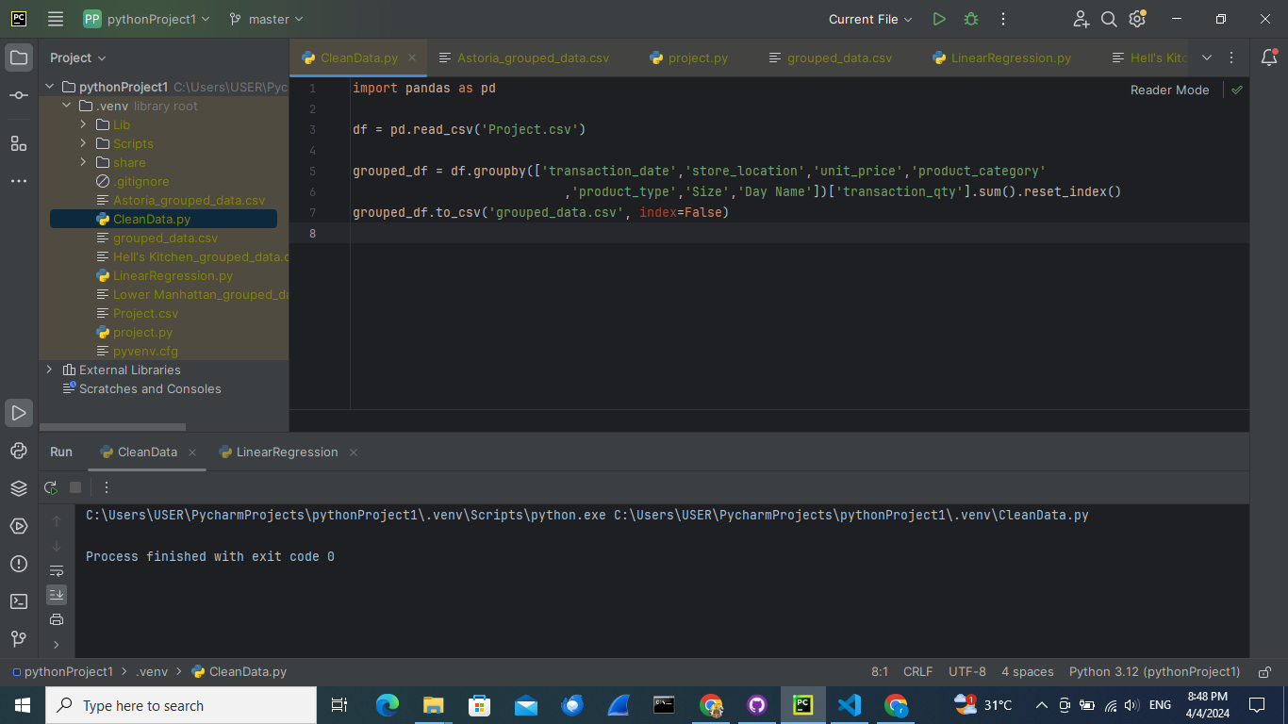

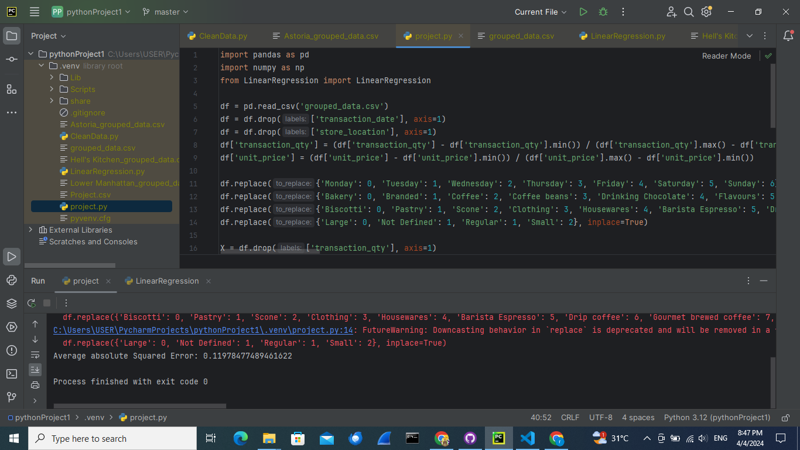
data cleaning
and feature selection
*we still keep transaction date and store location here because we want to separate sales of each day and each location
we drop it later

Slide 6



Linear Regression
since all data was relate to each other we can use linear regression to predict the sales quantity
is it worth?
+
=
size
price
coffee
customer demand

Slide 7
Absolute loss
We chose absolute loss for predicting coffee shop sales because it gives a clear picture of how many sales we are missing in our predictions
+
3
-

Slide 8

First test
≈
abs loss 4.3

Slide 9
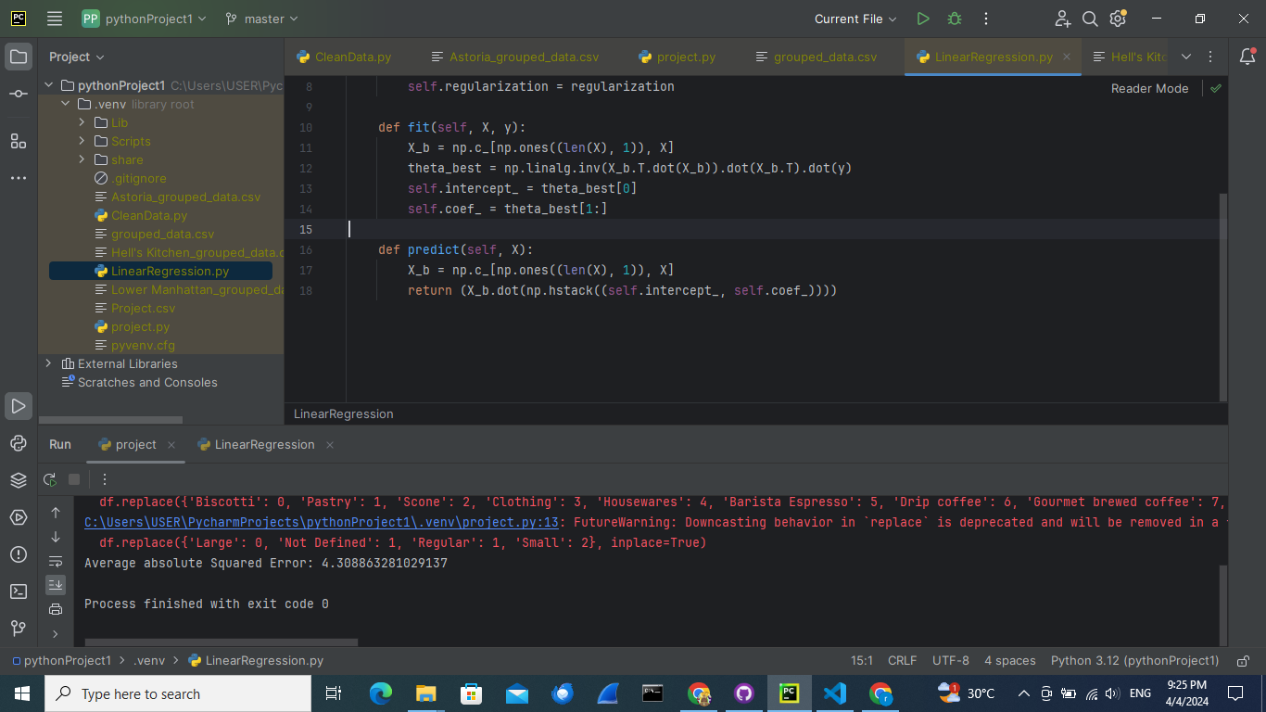



Prediction Problem
huh?
sometimes it can predict negative and float value
i would like to order -3.2589 cup of coffee

Slide 10
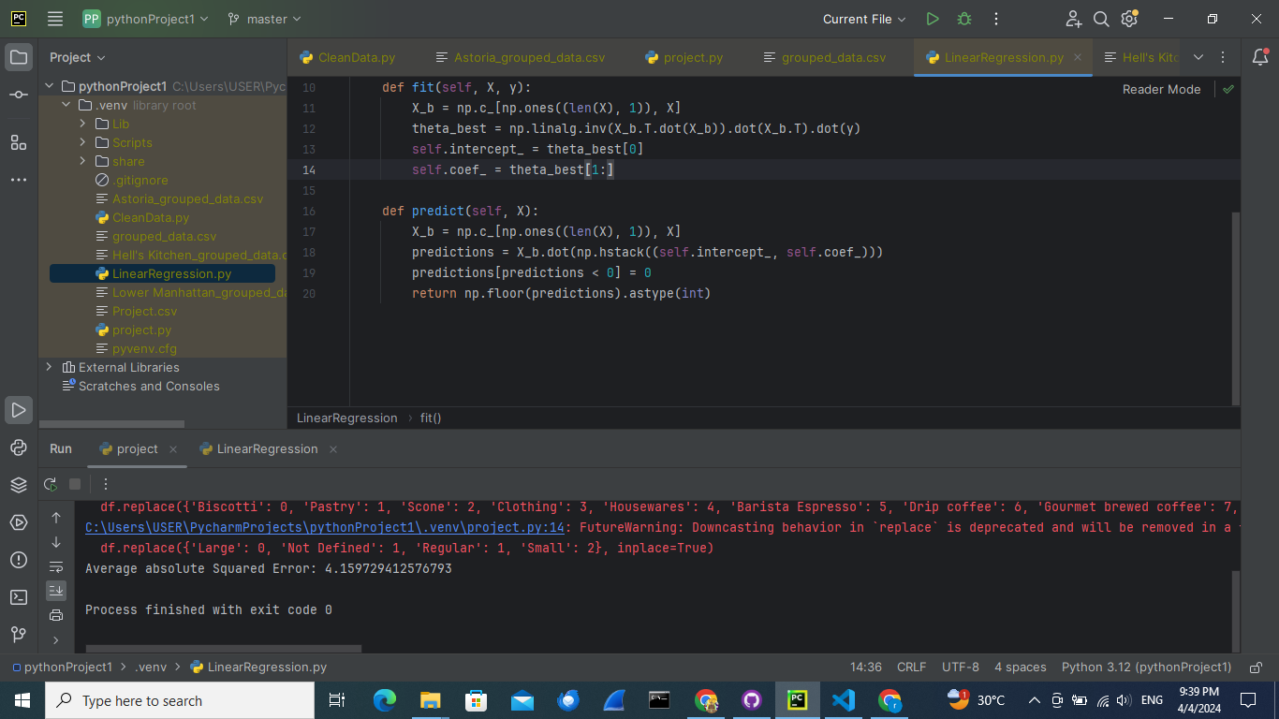
Prediction Problem
if it less than 0 its 0 and round everything down
0 cup of coffee
and 1 cup of tea

Slide 11

Second test
What’s problem
≈
abs loss 4.15

Slide 12
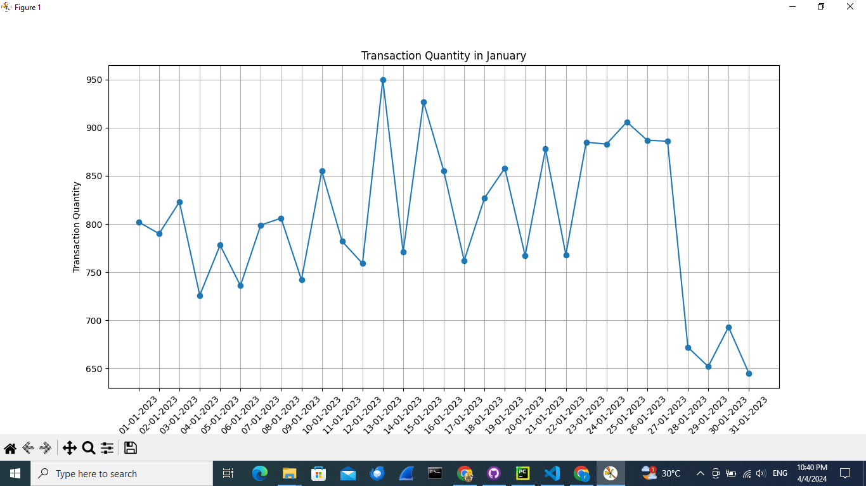
Outliers

Slide 13
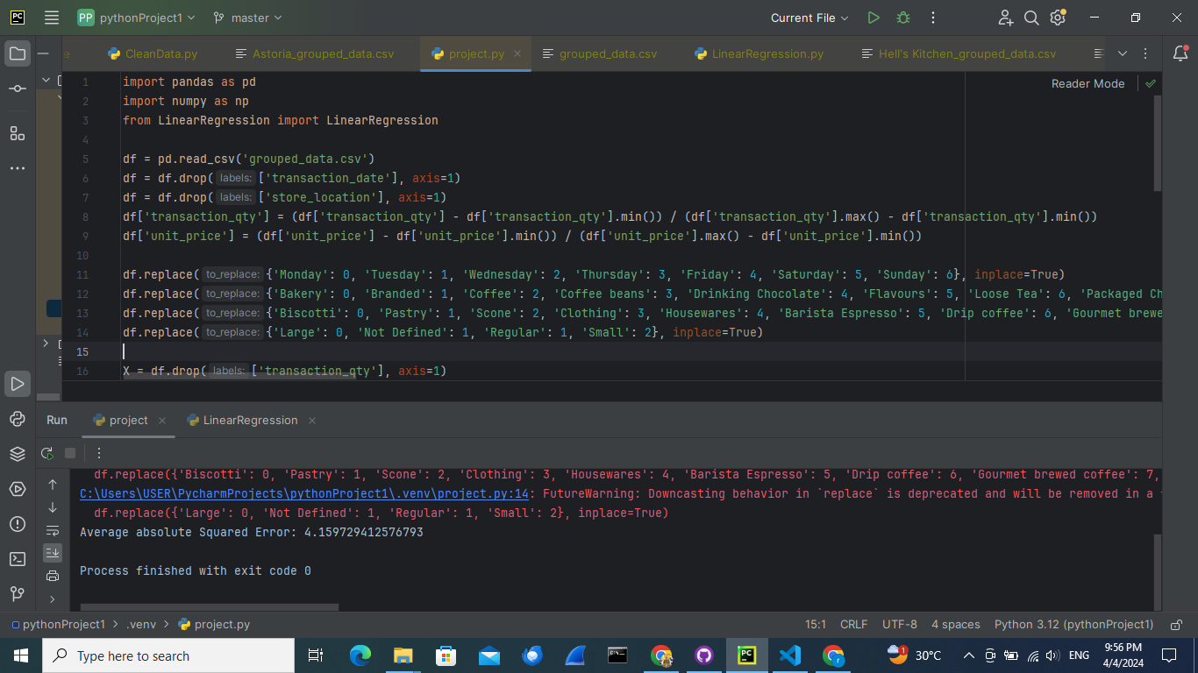
Normalize
x(max)−min(x)
​
x = x−min(x)

Slide 14


final test
≈
abs loss 0.12

